Slide 1
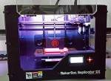
3D Printing Tutorial
BY Jocelyn Dialectos

Slide 2
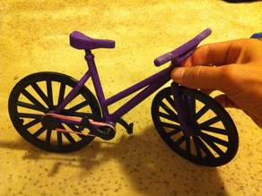
My Bicycle Project
For my Independent Study project, I chose to make a 3D printed bicycle.
my bike model from www.Thingiverse.com

Slide 3
Downloading .stl Files
(for projects NOT to be made from scratch)
go to a website, such as www.Thingiverse.com to download the .stl files
download the files for the desired project and save to the desktop
these .stl files will be opened in Makerware to “slice” and prepare them to be printed

Slide 4
Using Makerware
open the program Makerware
click File
choose Open
select the first .stl file from your saved downloads
if asked, allow the program to move the file to the plate
click Makerware and hover over settings
make sure the correct printer is set up
click the M in the top middle of the screen to “make” the .stl file into a .x3g file ready to be inserted into the 3D printer
save each file (there will now be a .stl file and a .x3g file for each download)

Slide 5
Transferring the Files
transfer the new files made by Makerware to an SD card
this card allows the files to be inserted into a 3D printer
insert the card into the spot provided by the printer

Slide 6
Printing the Product
change the colors- only two colors are possible
find the desired file on the printer’s screen and highlight it with the arrows
press the M button in the middle to print the object
repeat this slide for all files

